Slide 1

Central Dogma
Prepared by
Dr. Rawa Abdul Redha Aziz
Ph.D Antibiotics/ Molecular biology
Dr. Hiba Shakir Ahmed
Ph.D Microbiology/Immunity

Slide 2
RNA and its types
-RNA is the bridge between genes and the proteins for which they code and its types are:

Slide 3
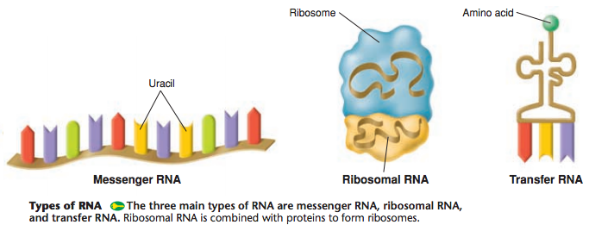

Slide 4
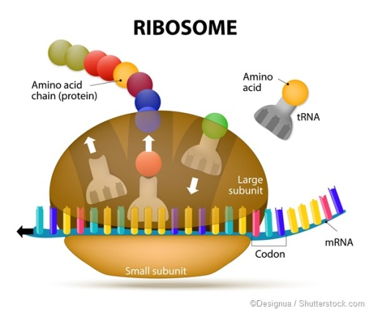
Codons
• A codon is three nucleotides in a row on an RNA molecule that codes for a single amino acid. There are 64 codons, but only 20 amino acids.

Slide 5
2. Transcription
- DNA is transcribed into a special type of RNA called messenger RNA, or mRNA
mRNA synthesis is catalyzed by RNA polymerase, which pries the DNA strands apart and hooks together the RNA nucleotides.
-The RNA is complementary to the DNA template strand
- RNA synthesis follows the same base-pairing rules as DNA, except that uracil substitutes for thymine

Slide 6
Initiation: RNA polymerase binds to the promoter of a gene and begins to unwind the DNA
Elongation: RNA pol ‘reads’ the template strand in 3’ to 5’ direction and adds complementary ribonucleotides. Actually 24/s in eukaryotes and 60/s in prokaryotes

Slide 7
Termination: RNA pol hits a stop signal (prokaryotes) or falls of (eukaryotes). In bacteria, the polymerase stops transcription at the terminator signal and the mRNA can then be translated without further modification.

Slide 9
Ribosomes
A ribosome is a protein consists of two subunits (70S in prokaryote and 80 S in Eukaryote), and it has three binding sites for tRNA
– The P site holds the tRNA that carries the growing polypeptide chain
– The A site holds the tRNA that carries the next amino acid to be added to the chain
– The E site is the exit site, where discharged tRNAs leave the ribosome.

Slide 10
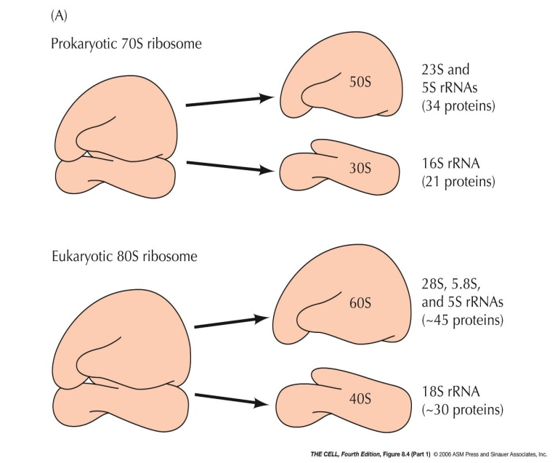

Slide 12
Translation
A cell translates an mRNA message into protein with the help of transfer RNA (tRNA)
• tRNA transfer amino acids to the growing polypeptide in a ribosome

Slide 13
• It has three stages:
Initiation: mRNA binds to the small ribosomal subunit. A special initiator tRNA binds to the mRNA+small ribosomal subunit. Initiator tRNA uses its anticodon to complementary base-pair with mRNA. So small ribosomal subunit “scans” along the mRNA until it finds the start signal methionine (AUG). Then large ribosomal subunit binds through GTP hydrolysis and begins elongation.

Slide 16
Elongation: Amino acids are added one by one to the preceding amino acid at the C-terminus of the growing chain. Each addition involves proteins called elongation factors and occurs in three steps: [codon recognition, peptide bond formation, and translocation]

Slide 17
Termination: The codons UGA, UAA, and UAG are stop signals. Instead of a tRNA binding there, a protein called a release factor binds and causes the ribosome to release. Many ribosomes can attach to one mRNA at once. This allows for very fast translation of multiple copies of the protein

Slide 20
Homework: Write the name of each of the characters below…

Slide 22

Any Question?

